Slide 1

Aviation Analytics
Presented by Group-3

Slide 2
Group Members
Meghana H D
PULAGAM KOUSHIK KUMAR REDDY
Saumya Amol Phule
Prathmesh Chintamani Ganar
Pratham Rathod
Amruta Shashank Patole

Slide 3
INDEX
Introduction to the Project
KPI's
Excel Dashboard
Power BI Dashboard
Tableau Dashboard
Conclusion
Challenges and Overcome

Slide 4
PROCESSING
data Cleaning
Data Visualization
Data Insights

Slide 5
Introduction
Aviation analytics is all about using data to understand and manage flights better. We look at things like when flights happen during the week, if they're delayed, or if they need to divert from their planned route. By studying these details and considering factors like weather or technical problems, we can spot patterns and predict potential issues. This helps airlines and aviation authorities plan better, making sure flights run smoothly and passengers get where they need to go safely and on time.

Slide 6






AVIATION ANALYTICS KPI’S
Weekday vs Weekend Total flight stats
Week wise, State wise and City wise statistics of delay of flights with airline details
Total number of cancelled flights for JetBlue Airways on first date of every month
Number of airlines with No departure/arrival delay with distance covered between 2500 and 3000
Airline wise Total Number of Flights Scheduled or Cancelled
Airline wise Total Number of Flights Diverted

Slide 7
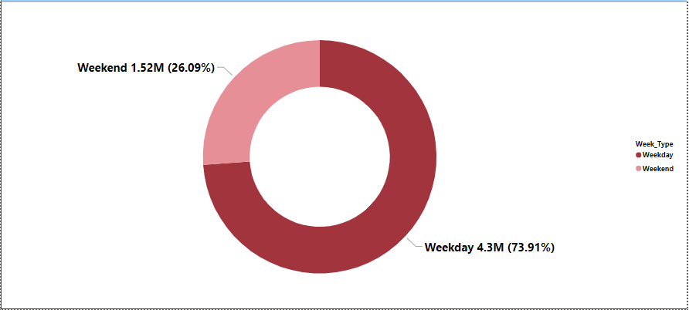
KPI_1: Weekday vs Weekend Total flight stats
The numbers show that there are a lot more flights happening on weekdays than on weekends. On weekdays, there are about 4,300,770 flights, while on weekends, there are only around 1,518,309 flights. This means airlines need to plan differently for weekdays and weekends. For busy weekdays, they might want to schedule more flights or use bigger planes to handle all the passengers. On weekends, they could consider cutting back on flights or using smaller planes because there are fewer people traveling. By adjusting their plans based on these numbers, airlines can make sure they're using their resources wisely and providing better service to their passengers.
Approximately 73.91% of flights occur on weekdays, highlighting the significance of weekdays in terms of flight activity.
Weekend flights make up 26.09% of the total, representing a smaller proportion compared to weekdays.

Slide 8
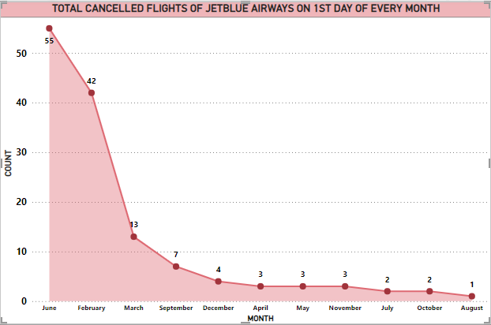
KPI_2: Total number of cancelled flights for JetBlue Airways on first date of every month
The highest number of cancelled flights for JetBlue Airways on the first date of every month was 55 in June.
The lowest number of cancelled flights was 0 in January.
February had the highest count with 20,517 cancellations, while September had the lowest count with 2,075 cancellations.
Among all airlines, WN had the highest count with 16,043 cancellations, while HA had the lowest count with 171 cancellations.
In a single month, MQ had the highest count with 3,887 cancellations, and HA had the lowest count with 3 cancellations.

Slide 9
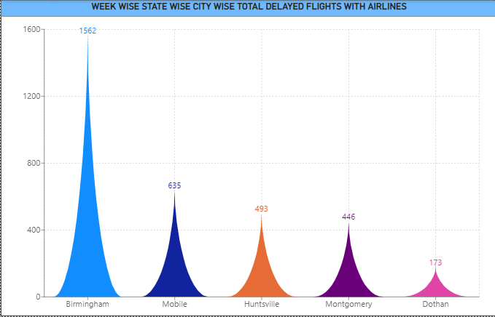
KPI_3: Week wise, State wise and City wise statistics of delay of flights with airline details
The data provides a comprehensive overview of flight delays categorized by week, state, and city, with a grand total of 803,663 delays recorded. States like California (96,147), Texas (100,037), and Florida (63,731) exhibit notably high delay counts, reflecting significant aviation traffic and potential operational challenges. Such insights highlight the need for airlines to focus on these regions to improve operational efficiency and passenger satisfaction. Moreover, cities within these states, such as Los Angeles, Dallas, and Miami, may require targeted strategies to address delay issues effectively. Looking ahead, airlines could invest in advanced scheduling algorithms and infrastructure upgrades to mitigate delays, optimize flight routes, and enhance overall service reliability. Additionally, fostering collaboration with local aviation authorities and implementing real-time communication channels for passengers can help manage expectations and minimize the impact of delays on travel experiences. By proactively addressing delay trends at both state and city levels, airlines can strive towards smoother operations and improved customer loyalty.

Slide 10
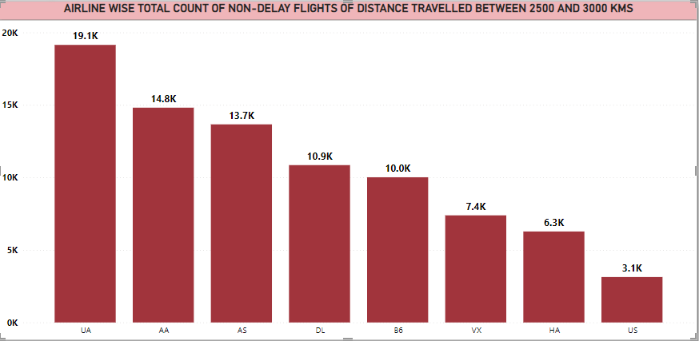
KPI_4: Number of airlines with No departure/arrival delay with distance covered between 2500 and 3000
The data reveals that a substantial number of flights operated by several major airlines, including Alaska Airlines Inc., American Airlines Inc., Delta Air Lines Inc., Hawaiian Airlines Inc., JetBlue Airways, United Air Lines Inc., US Airways Inc., and Virgin America, experienced no departure or arrival delays for flights covering distances between 2500 and 3000 miles, totaling 85,289 flights. This indicates a commendable level of operational efficiency and reliability among these carriers. However, it's worth noting that there are six additional airlines not meeting the specified conditions in the dataset. To enhance overall performance and ensure a consistent level of service across all airlines, future efforts could focus on sharing best practices and implementing industry-wide standards for operational excellence. Additionally, investing in advanced technologies for flight planning, maintenance, and crew scheduling could further optimize operations and minimize delays for all airlines, regardless of size or route network. By fostering collaboration and embracing innovative solutions, the aviation industry can collectively strive towards delivering a more seamless and reliable travel experience for passengers worldwide.

Slide 11
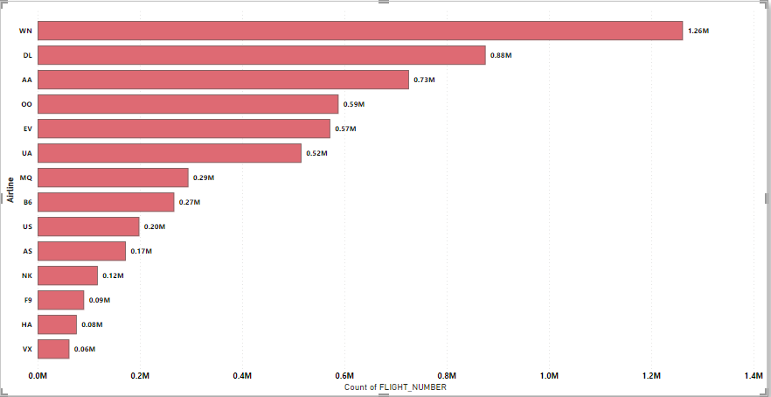

KPI_5: Airline wise Total Number of Flights Scheduled or Cancelled
The data shows a comprehensive overview of scheduled and cancelled flights for various airlines. Among the airlines, Southwest Airlines Co. has the highest number of scheduled flights, followed by Delta Air Lines Inc. and American Airlines Inc. On the other hand, American Airlines Inc. recorded the highest number of cancellations, followed by Southwest Airlines Co. and Delta Air Lines Inc. These insights highlight the significant impact of cancellations on operational efficiency and passenger experience. To address this, airlines could focus on improving operational reliability through enhanced maintenance procedures, efficient scheduling, and better communication with passengers during disruptions. Implementing proactive measures and investing in advanced technologies could help minimize cancellations and ensure smoother operations, ultimately leading to improved customer satisfaction and loyalty. By prioritizing these strategies, airlines can strive to deliver a more seamless and reliable travel experience for passengers.

Slide 12
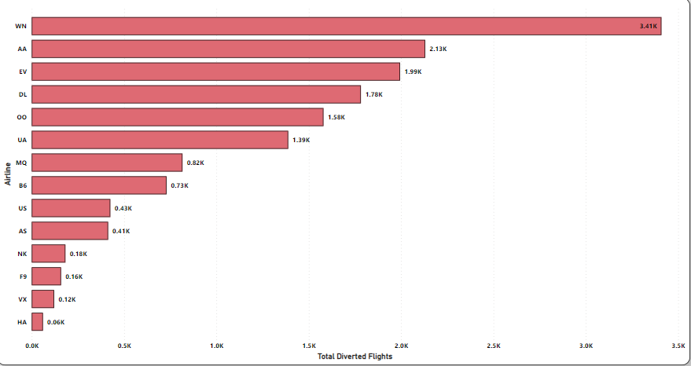
KPI_6: Airline wise Total Number of Flights Diverted
The data reveals the total number of flights diverted for each airline, with Southwest Airlines Co. experiencing the highest count, followed by American Airlines Inc. and SkyWest Airlines Inc. Insights drawn from this analysis underscore the importance of implementing measures to mitigate flight diversions and their associated disruptions. Airlines could focus on enhancing operational preparedness by investing in advanced weather forecasting technologies, improving maintenance protocols, and optimizing route planning to minimize the likelihood of diversions. Additionally, fostering closer collaboration with air traffic control authorities and airport operators can facilitate more efficient handling of diversions when they do occur, ensuring smoother transitions for passengers and minimizing inconvenience. By prioritizing these strategies, airlines can work towards reducing the impact of flight diversions on both operational efficiency and passenger satisfaction, ultimately enhancing overall reliability and service quality.

Slide 13
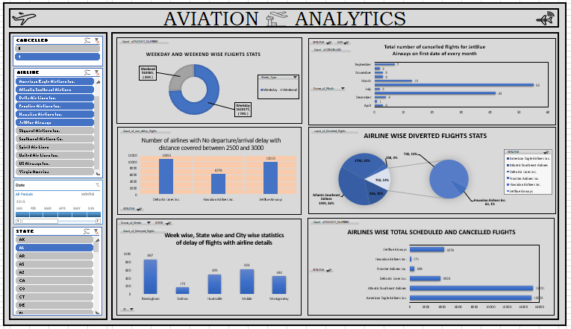
Excel Dashboard

Slide 14
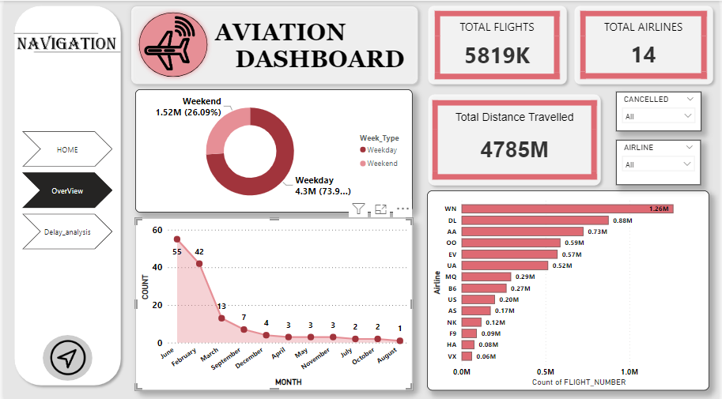
Power BI Dashboard

Slide 15
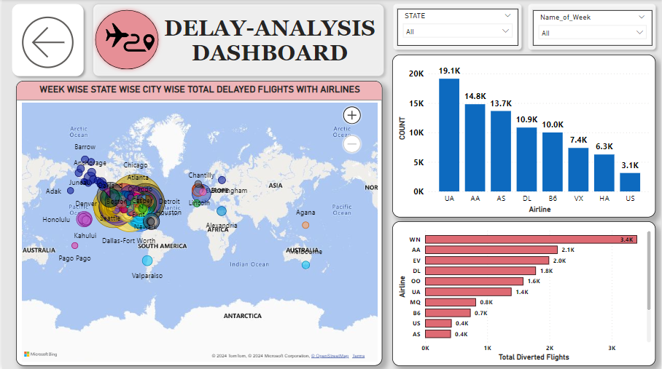
Power BI Dashboard

Slide 16
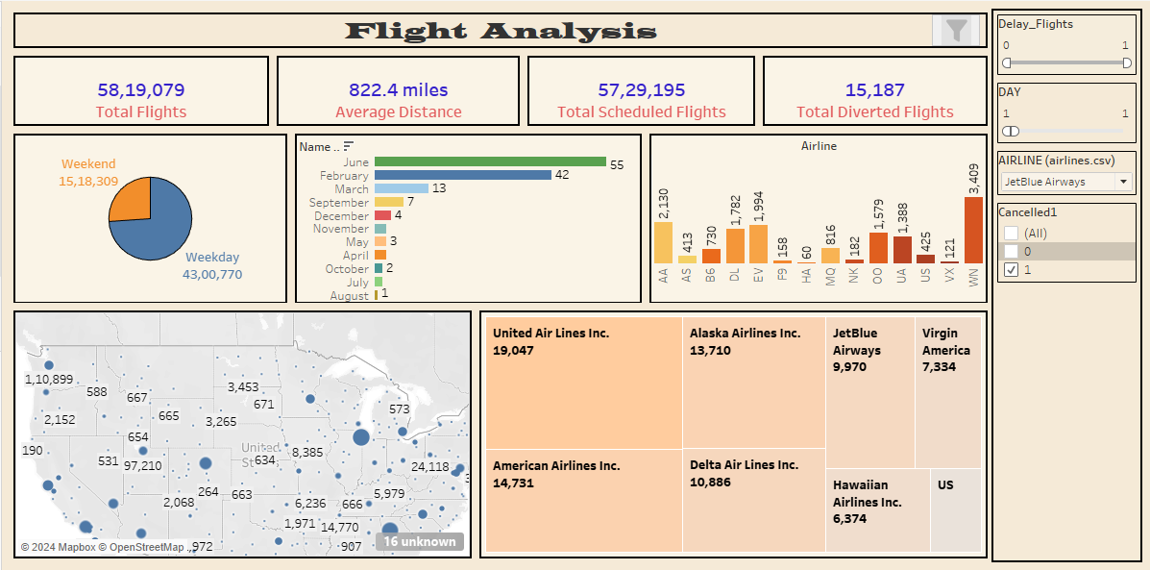
Tableau Dashboard

Slide 17
Conclusion
Impact of Aviation Analytics
Aviation analytics has revolutionized the industry by providing valuable insights and data-driven decision-making. It has helped airlines optimize operations, improve safety, and enhance the overall passenger experience.
Future Opportunities
As technology continues to advance, there are even more opportunities for aviation analytics. With the integration of artificial intelligence and machine learning, airlines can further enhance their operations and offer personalized experiences to passengers.
Importance of Data Security
While aviation analytics offers numerous benefits, it is crucial to prioritize data security and privacy. Airlines must implement robust security measures to protect sensitive passenger information and maintain customer trust.

Slide 18
Challenges
Data Collection
The aviation industry generates massive amounts of data, making it challenging to collect and process.
Overcome: Implementing advanced data collection systems and leveraging automation to streamline the process.
Data Integration
Integrating data from various sources and formats can be complex and time-consuming.
Overcome: Developing data integration frameworks and utilizing data integration tools to streamline the process.
Data Analysis
Analyzing and deriving insights from large volumes of aviation data can be challenging.
Overcome: Utilizing advanced analytics techniques, such as machine learning and predictive modeling, to extract valuable insights from the data.

Slide 19

Thank You

